Slide 1

Nlog configuration
Wojciech Grzesiak

Slide 2
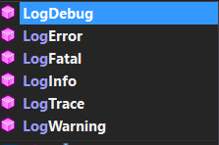
NLog
NLog is a free logging platform for .NET
Allows user to store logs in :
Files
Console
Databases
E-mail
Event log
ASP.NET trace
Each log can be assigned to one level of this group :

Slide 3
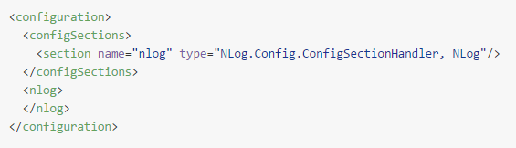
Nlog Configuration file
Standard configuration file :
Configuration elements that You can use as children to <nlog />:
- <targets /> defines log targets/outputs
- <rules /> defines log routing rules
- <extensions /> loads Nlog enxtensions from the *.dll file
- <include /> includes external configuration file
- <variable /> sets the value of a configuration variable

Slide 4
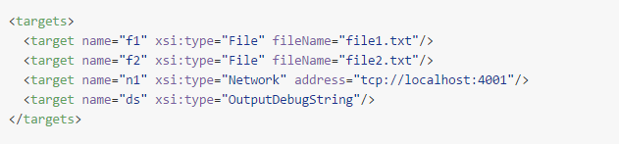
Targets
The <targets /> section defines log targets. Each target is represented by a element. There are two attributes required for each target:
Name (target name)
Type (target type such us „File”, „Database” ...)
Example:

Slide 5
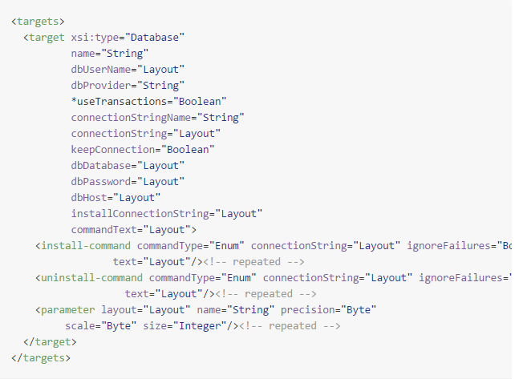
Target Database

Slide 6
Layouts and layout renderers
One of the Nlog’s strongest assets is the abbility to use layouts. In the simplest form layouts are texts with embedded tags delimited by ${ ...}.
The tags are called Layout renderers and can be used to insert pieces of contextual information into the text.
<target name="c" xsi:type="Console" layout="${longdate} ${callsite} ${level} ${message}"/>
Log will consist of :
current date and time
name of the class and method that emitted the log message
log level
message text

Slide 7

Layouts and layout renderers
We can make each messages for each logger go to a separate file, as in the following example:
As you can see, the ${logger} layout renderer was used in the fileName attribute, which causes each log message to be written to the file whose name includes the logger name. The above example will create the following files:
Name.Space.Class1.txt
Name.Space.Class2.txt
Name.Space.Class3.txt
Other.Name.Space.Class1.txt
Other.Name.Space.Class2.txt
Other.Name.Space.Class3.txt

Slide 8
Rules
Each routing table entry is a <logger /> element, which accepts the following attributes:
Name : source/logger name
Minlevel : minimal log level for this rule to match
Maxlevel : maximum log level for this rules to match
Level : single log level for this rule to match
Levels : comma seperated list of log levels for this rule to match
writeTo : comma seperated list of target that should be written to when this rule matches
Final : make this rule final. No further rules are processed when any final rule matches
Enabled : setting enabled to false allow to disable this rule. Disabled rules are ignored

Slide 9

Rules - Examples
- All messages from the Class1 in the Name.Space whose level is Debug or higher are written to the "f1" target:
- All messages from the Class1 in the Name.Space whose level is either Debug or Error or higher are written to the "f1" target:
- Messages from any class in the Name.Space namespace are written to both "f3" and "f4" targets regardless of their levels:
- Messages from any class in the Name.Space namespace whose level is between Debug and Error (which makes it Debug, Info, Warn, Error) are rejected (as there’s nowriteTo clause) and no further rules are processed for them (because of thefinal="true" setting)

Slide 10
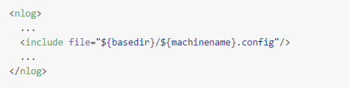
Include files
It’s sometimes desired to split the configuration file into many smaller ones. NLog provides an include file mechanism for that. To include an external file, you simply use <include file=”…” /> element.
The following configuration example demonstrates this, by loading a file whose name is derived from the name of the machine we’re running on.

Slide 11

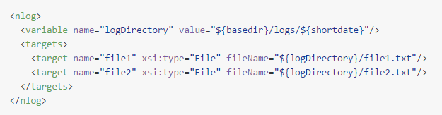
Variables
Variables can be used to write complex or repeated expressions (such as file names) in a concise manner. To define a variable use the following syntax:
Once defined, variables can be used as if they were layout renderers – by using ${var}syntax, as demonstrated in the following example:

Slide 12

Automatic reconfiguration
NLog can monitor logging configuration files and re-read them each time they are modified. To enable this mechanism, you simply add autoReload="true" parameter to the configuration file.

Slide 13
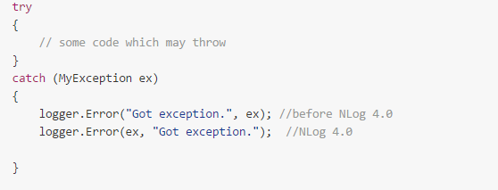
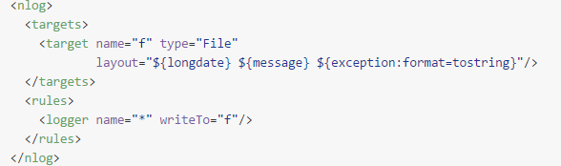
Logging exceptions
You typically log exceptions inside a catch handler. An example of logging an exception with the Error LogLevel is seen in the following:
C# :
XML :

Slide 14
Logging exceptions
${exception:innerFormat=String:maxInnerExceptionLevel=Integer:innerExceptionSeparator=String :separator=String:format=String}
innerFormat - Format of the output of inner exceptions. Must be a comma-separated list of exception properties: Message, Type, ShortType, ToString, Method, StackTrace. This parameter value is case-insensitive.
maxInnerExceptionLevel - Maximum number of inner exceptions to include in the output. By default inner exceptions are not enabled for compatibility with NLog 1.0.Integer. Default: 0
innerExceptionSeparator - Separator between inner exceptions. Default: new line
separator - Separator used to concatenate parts specified in the Format. Default: single space
format - Format of the output. Must be a comma-separated list of exception properties: Message, Type, ShortType, ToString, Method, StackTrace, Data. This parameter value is case-insensitive. Default: message

Slide 15
Usefull websites
https://github.com/nlog/NLog/wiki/Configuration-file

